Slide 1
Deep Analytics and Time Series Analysis into Submetering
Gavin Bougadis

Slide 2
Step 1: Visualizations

Slide 3
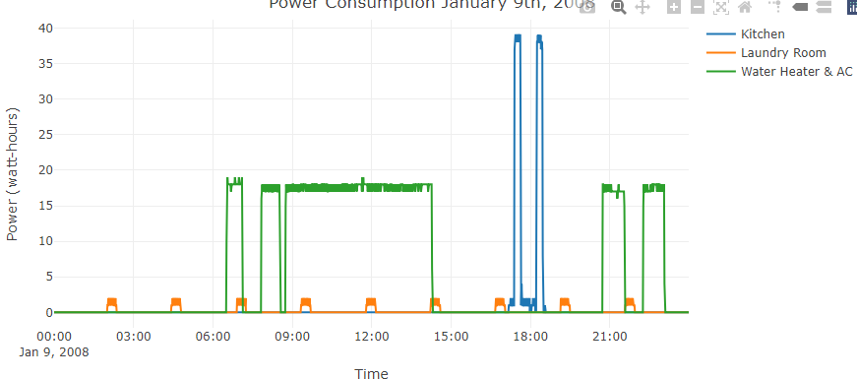
Intraday Visualizations
Date: January 9th, 2008
Key Insights
Most power for sub-meter 1 (which corresponds to the kitchen) is consumed in the evening around 6 p.m.
most likely corresponds with people getting back from work and making dinner.
Laundry room contains the refrigerator which would explain why there are consistent spike intervals due to the intermittent running of refrigerators.

Slide 4
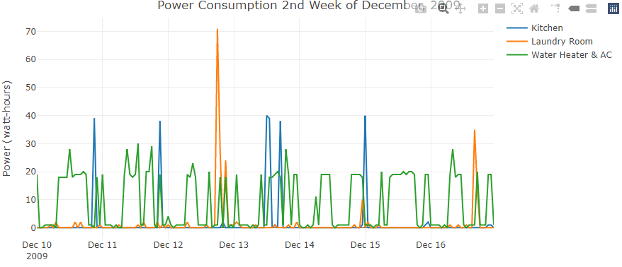
Energy usage in the winter
Date: 2nd Week of December, 2009
Key Insights
In the winter it can cost more to heat the apartment, therefore the average Water Heater & AC energy usage is higher.

Slide 5
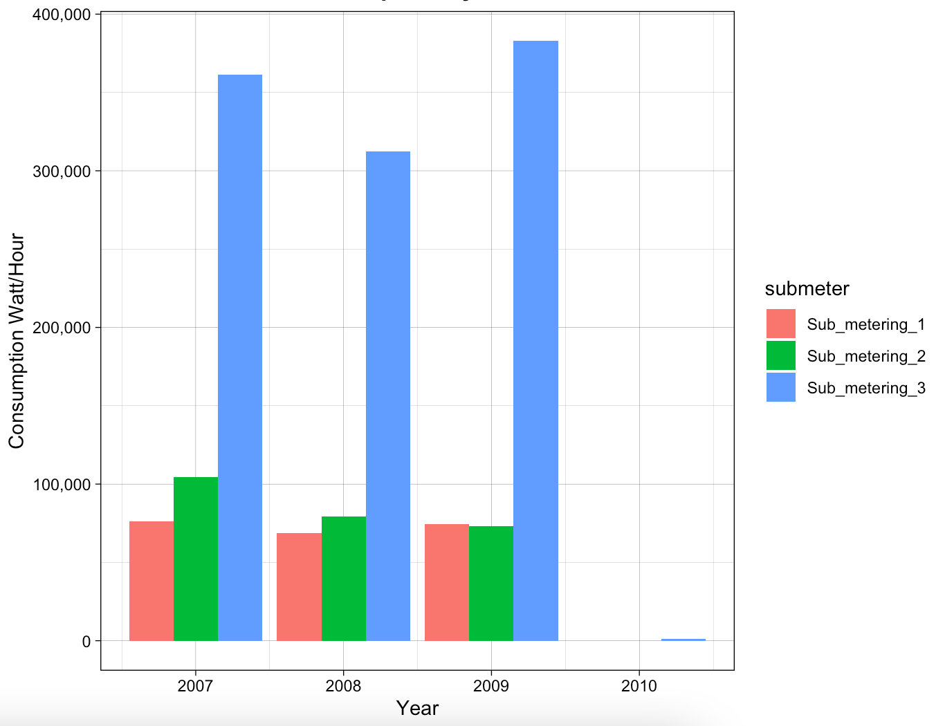
Sub-meter usage over the years
Key Insights
Energy usage is quite consistent between sub-meter 1 and 2 throughout the years.
Sub-Meter 3 introduces the most variability year-over-year

Slide 6
Step 2: Time Series with Analysis

Slide 7
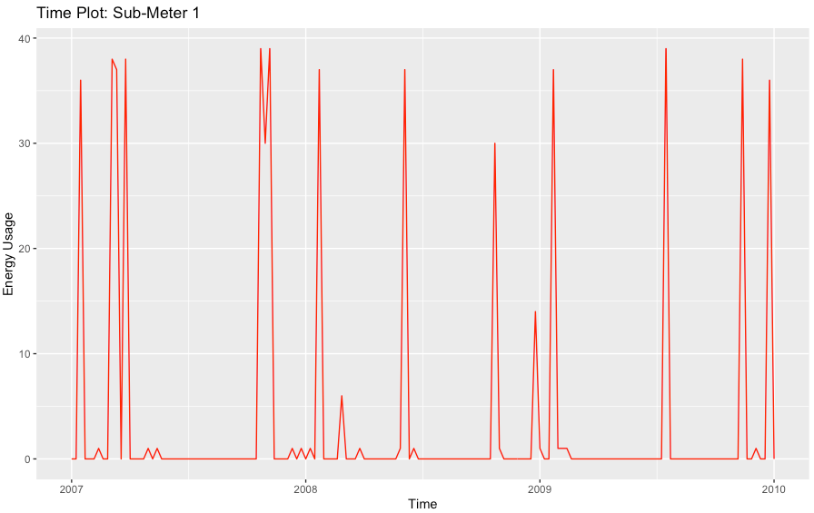
Sub-Meter 1 Time Series
The figure on the right plots our time series for
\every Sunday at 12 p.m for sub-meter 1.
Key Insights
There are consistent spikes in the data. Because the seasonal fluctuations are roughly constant overtime, it is reasonable to say that an additive model can be used to describe it.

Slide 8
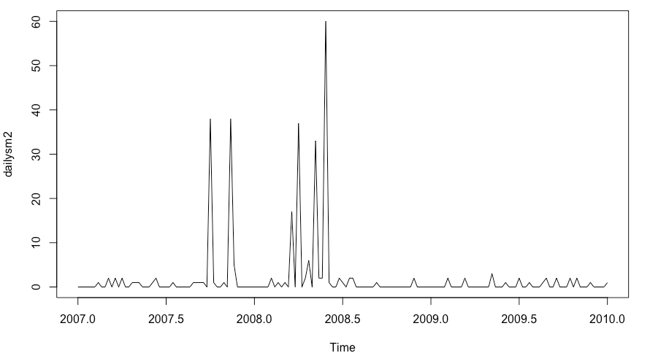
Sub-Meter 2 Time Series
For this time-series we will be looking at a
common dinner hour (6 p.m.) on Wednesdays
from 2007-2010.
Key Insights
Time-Series 2 can have unexpected spikes of energy but for the majority, remains a low energy consumption sub-meter.

Slide 9
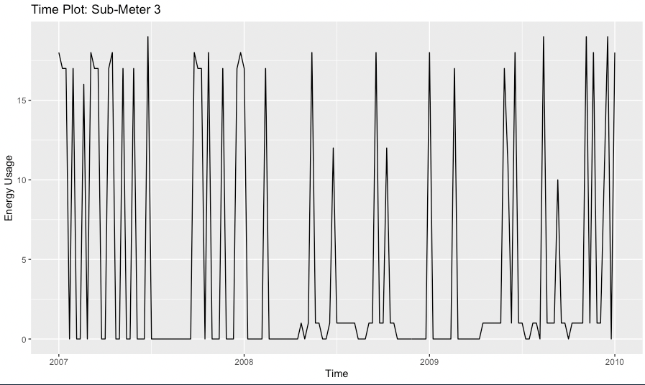
Sub-Meter 3 Time Series
Key Insights

Slide 10
Step 3: Decomposition

Slide 11
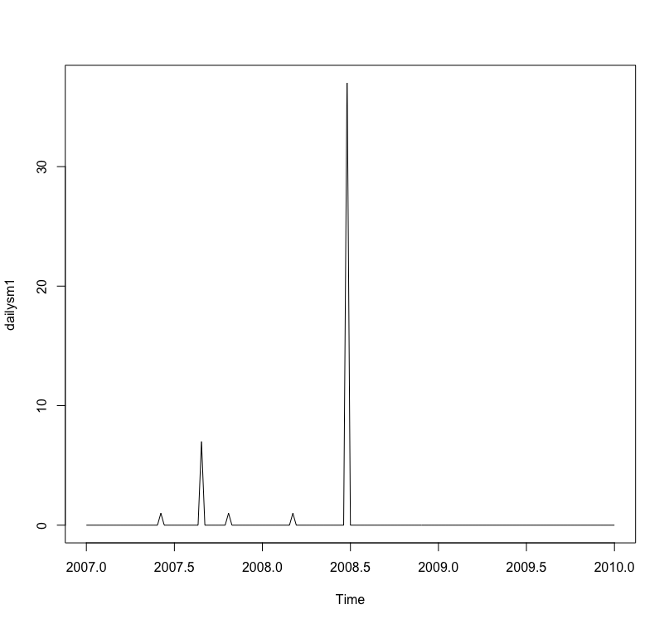
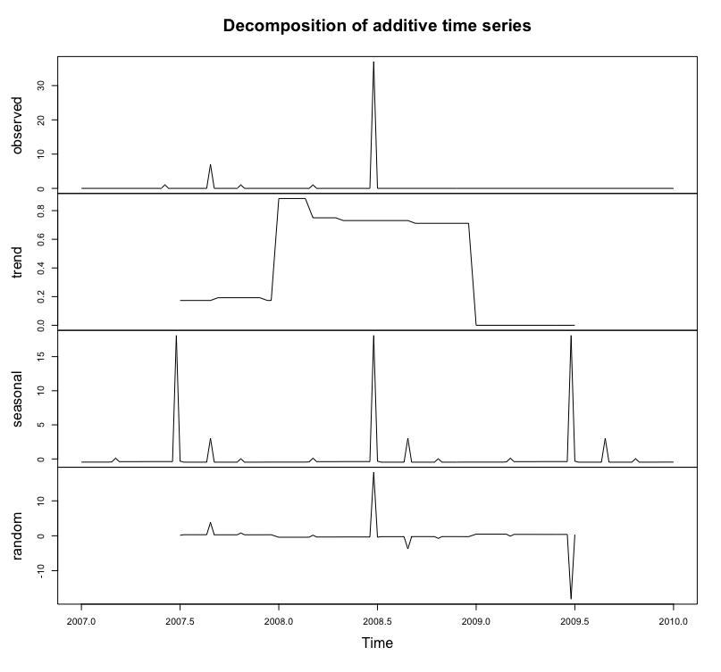
Decomposition of Sub-Meter 1
Key Insights:
Fluctuations in the time series are roughly constant so this can be described using an additive model.
We can see through decomposition that there is one large spike and that the seasonality increases half through each year

Slide 12
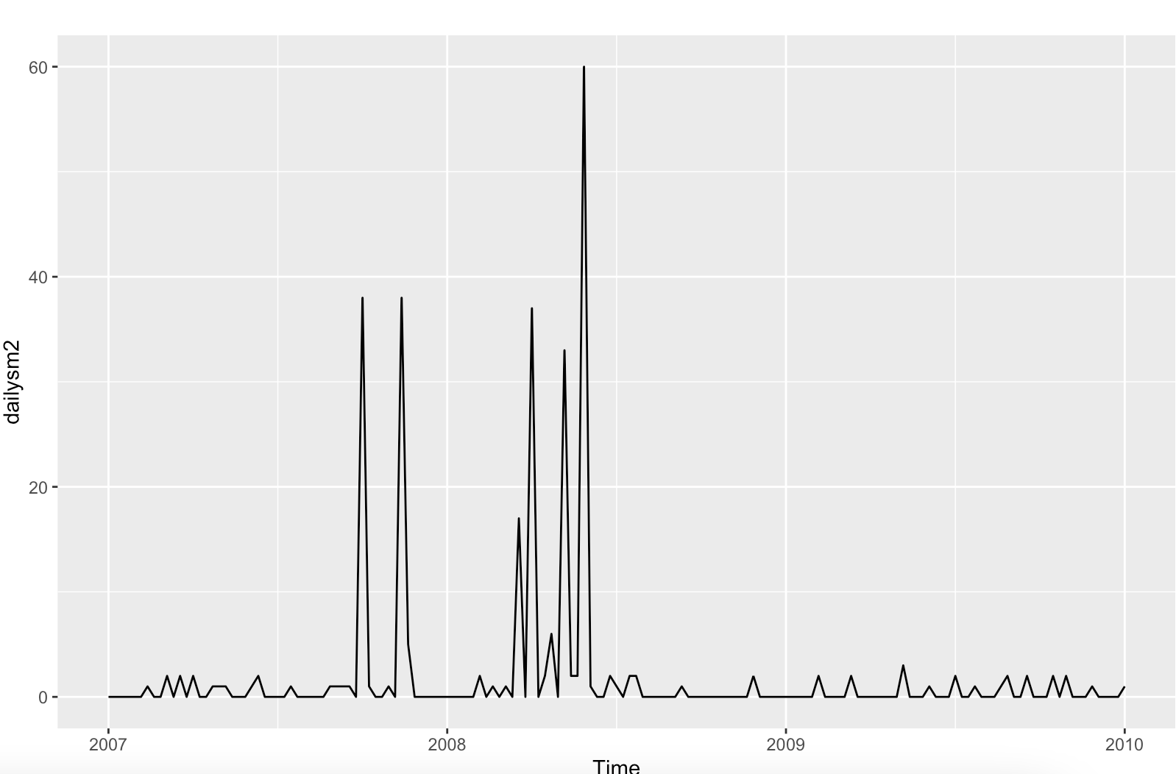
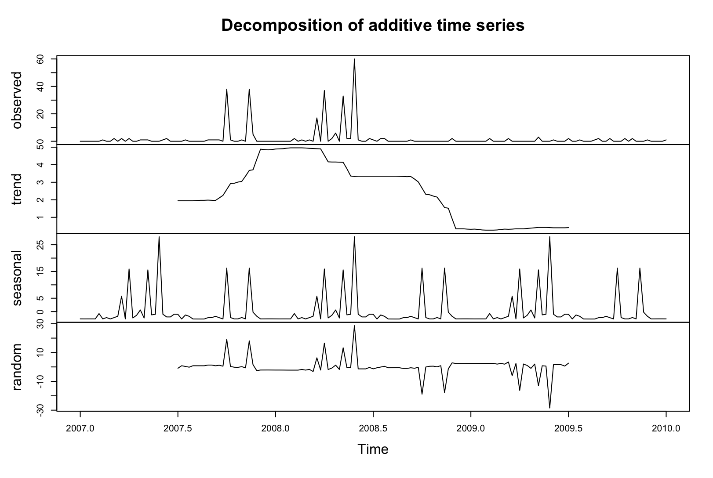
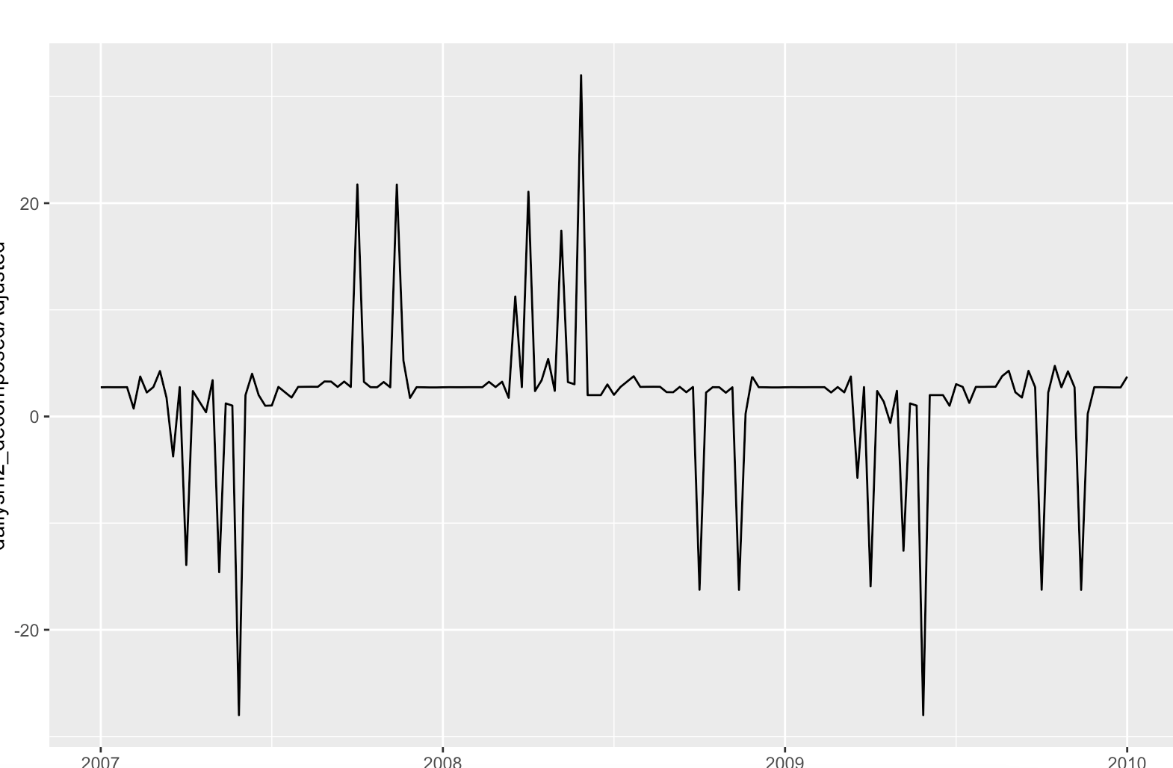
Decomposition of Sub-Meter 2
Pre-Seasonal Adjustment:
Key Insights:
There was a seasonal adjustment that needed to be made for Sub-Meter 2 due to the peaks every year in Q4.
By removing the seasonality we can see the trend for Sub-Meter 2 and notice large negative spikes half-way through 2007 and 2009.
This is important for renters to better understand their energy consumption
Post-Seasonal Adjustment:

Slide 13
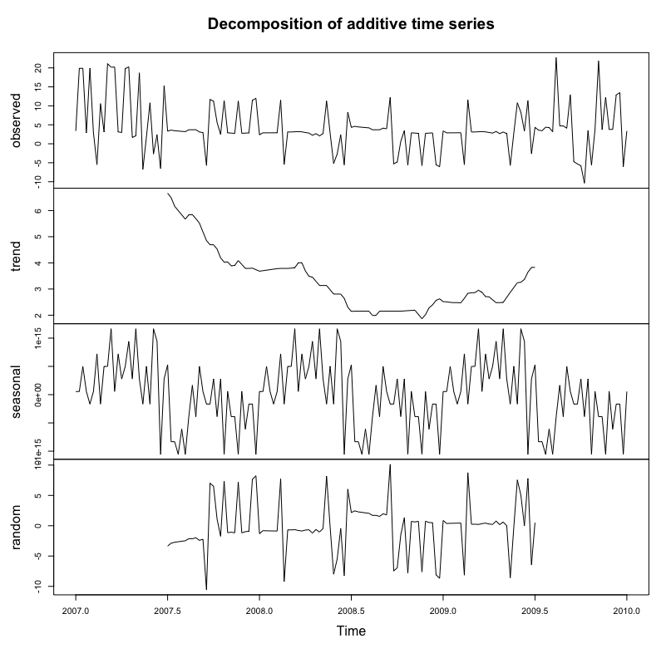
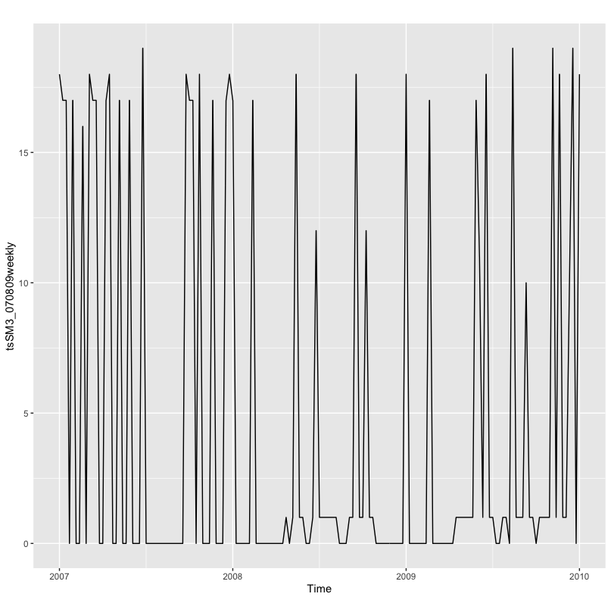
Decomposition of Sub-Meter 3
Key Insights:
The trend in energy usage steadily decreases until the end of 2008 , where we see a slight increase in energy consumption.
Seasonality shows fairly consistent usage. We can confirm this by looking at the plot as the peaks and troughs are not dependent on one part of each year

Slide 14
Step 4: Holt-Winters Forecasting

Slide 15
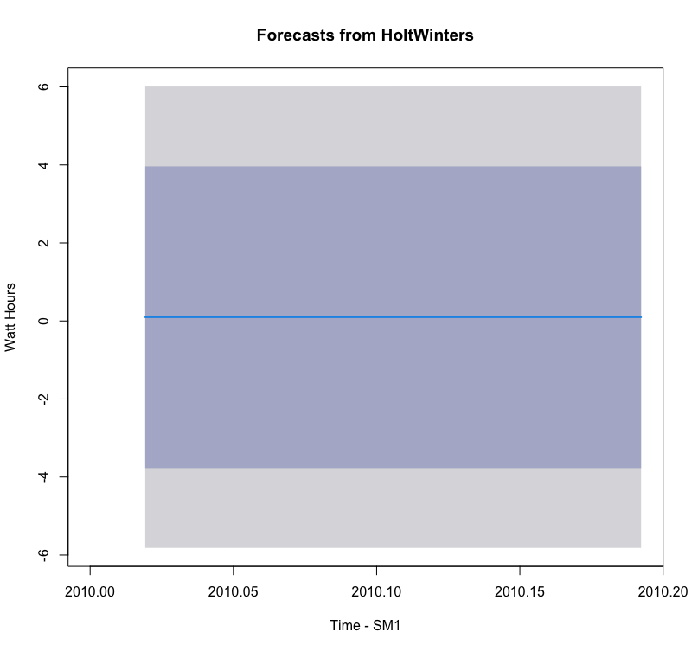
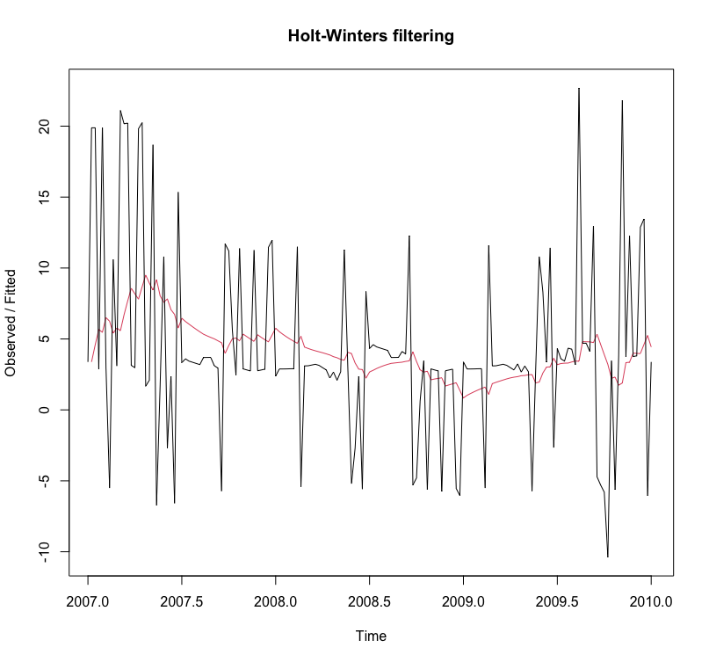
Holt-Winters: Sub-Meter 1
Exponentially Smoothed (Holt-Winters) Plot:
Holt-Winters forecast:
Key Insights:
With the exponential smoothing we can see the forecast is much more consistent and we are able to plot only the future forecast.
95% CI falls at 4 and the forecast is near 0 for the first half of 2010.

Slide 16
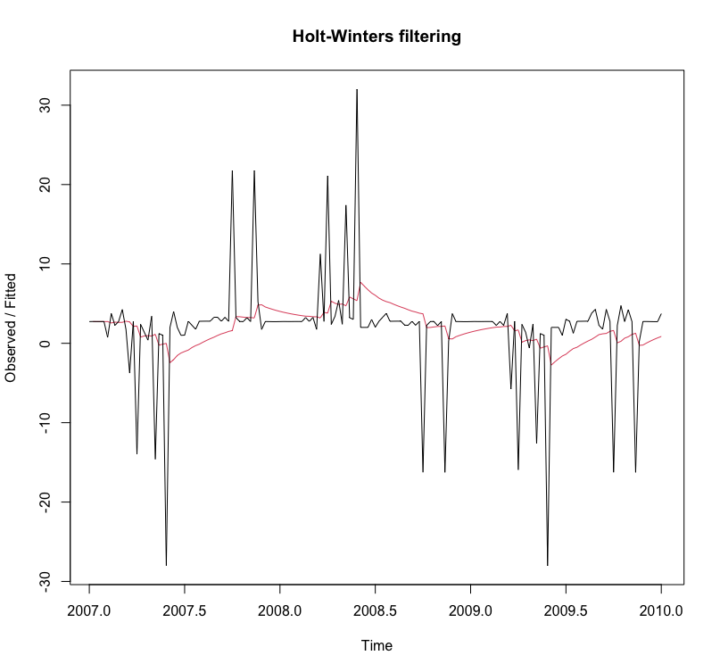
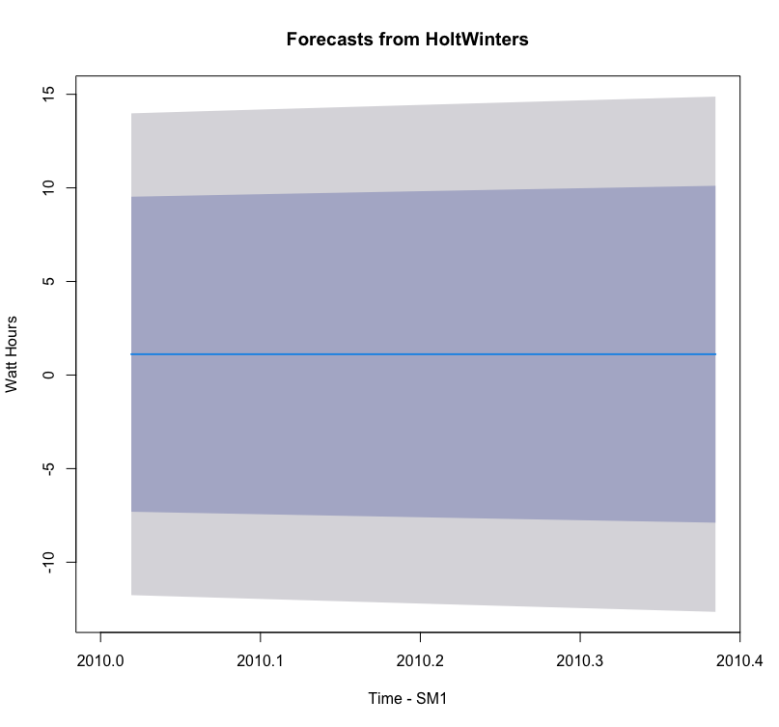
Holt-Winters: Sub-Meter 2
Exponentially Smoothed (Holt-Winters) Plot:
Holt-Winters forecast:
Key Insights:
Holt-Winters makes our forecast fairly consistent once again and is expected to be slightly above 0 for SM2
Confidence interval of 95% is slightly higher with a near 10 and a low near -8.

Slide 17
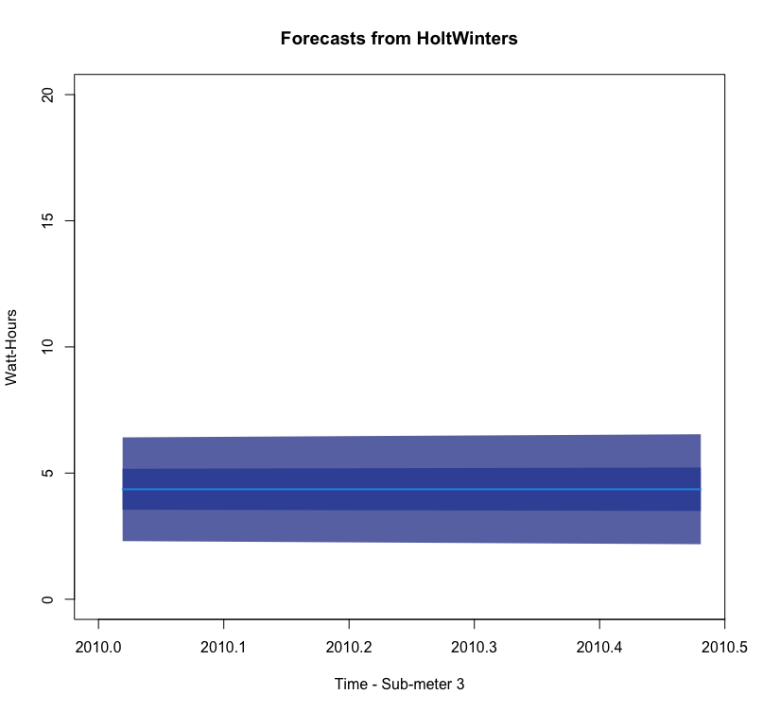
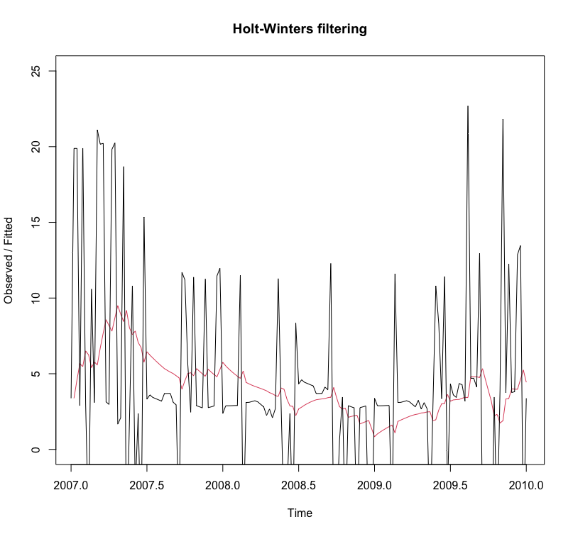
Holt-Winters: Sub-Meter 3
Holt-Winters forecast:
Exponentially Smoothed (Holt-Winters) Plot:
Key Insights:
With the exponential smoothing, we can expect the Watt-Hours of SM3 to fall around 5 for the first half 2010.

Slide 18
Correlations
Additional correlations may be found among more renter demographics such as age, duration of lease, etc.

Slide 19
Summary/Business Actions

Slide 20
Goal:
Identify power usage patterns
Are the patterns unusual or not?
Recommendations
Actions:
Develop annual/monthly/weekly reports of energy consumption for owners to easily track energy
Notify when there are spikes in energy consumption so they can attempt to change behavior
Use forecasting to let renters know what to expect in the future
Recommend actions renters can take to keep energy consumption lower when there are seasonal rises in energy consumption
Transparency with renters with improve trust

Slide 21
Lessons Learned

Slide 22
Lessons Learned
By forecasting we can potentially help owners understand how much energy they can expect to use and understand why they are being charged what they are
We can also help explain what may be using the most energy in homes and help assist with lowering the cost of energy consumption.

